Slide 1


Heroes and Legends:
Magical Musical Tales
Symphony Day
Learning Guide
October 23 & 24, 2024 The Fox Theater

Slide 2
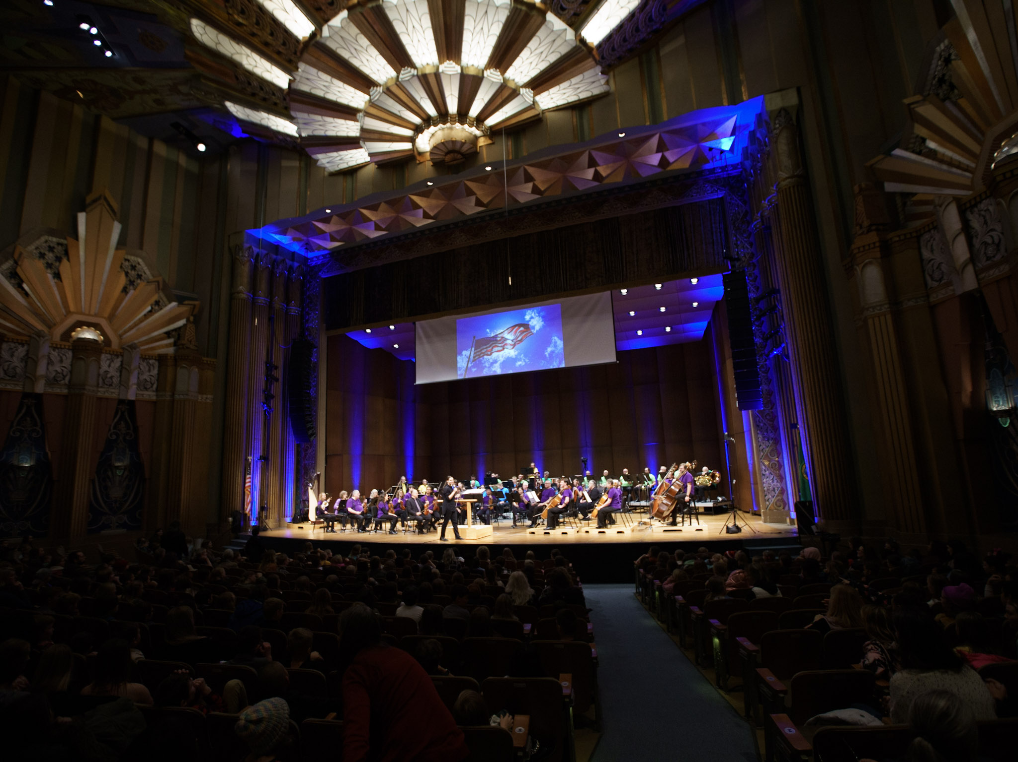
PROGRAM
John Smith: Star-Spangled Banner
Paul Dukas: The Sorcerer’s Apprentice
Peter Ilyich Tchaikovsky: Waltz from Swan Lake, Op. 20, Act 1: No. 2
Grace Williams: “The Conflict” from Four Illustrations from the Legend of Rhiannon
Edvard Grieg: “Morning Mood” from Peer Gynt Suite No. 1, Op 46
Gioachino Rossini: William Tell Overture
Igor Stravinsky: The Firebird Suite: Finale
And, one more special surprise!

Slide 3
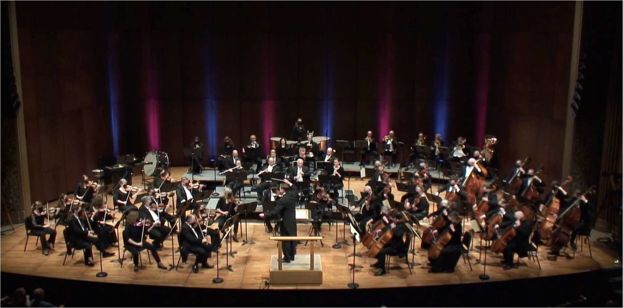
Hello, we are thrilled that you will be joining us for the SSO Symphony Day in October! In this guide we’ll introduce the orchestra, conductor, and the music that the orchestra will perform for you. Let's get started!
So, what is an orchestra? An orchestra is simply a group of musicians who play instruments together. Most symphony orchestras have a special sound that is created by joining four groups of instruments: strings, woodwinds, brass, and percussion. The musicians of the Spokane Symphony have moved from all over the country and world (including Venezuela, China, Morocco, and Germany) to live in Spokane and perform for you.
To be a professional musician, you need to practice your instrument for many years. Most symphony musicians specialize in only one or two instruments. Think of your favorite professional sports athlete. A quarterback learned to play football as a kid and practiced their skills (a lot!)—and even as a professional they still practice for hours every day. It is similar with a professional musician; we all started to play music when we were kids and practiced our instrument a lot! And we still regularly practice so we can perform at a high level and learn new music for every concert.
Spokane Symphony with Music Director, James Lowe performing onstage at The Martin Woldson Theater at The Fox

Slide 4
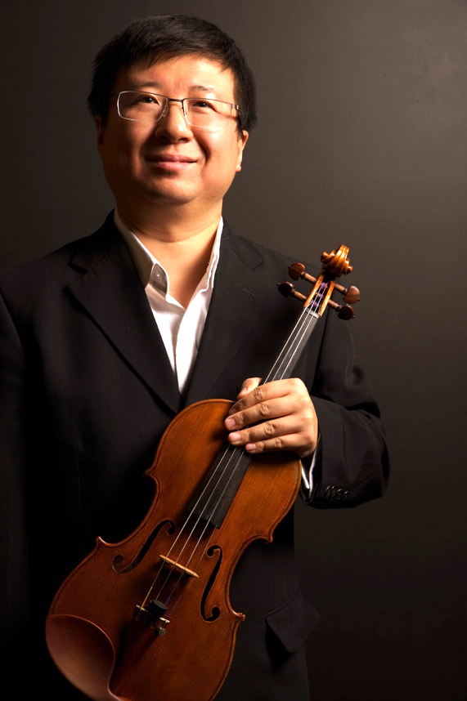
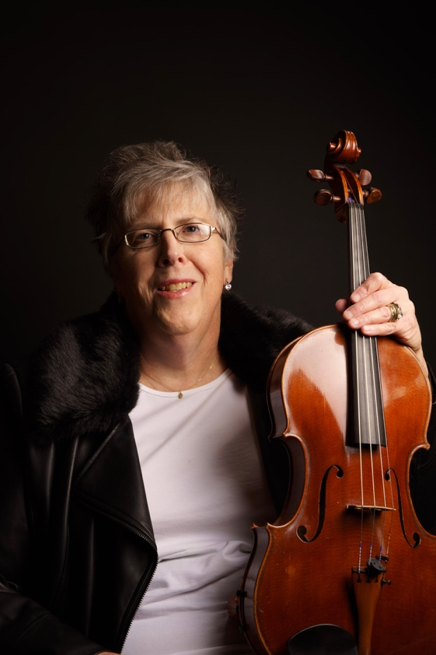
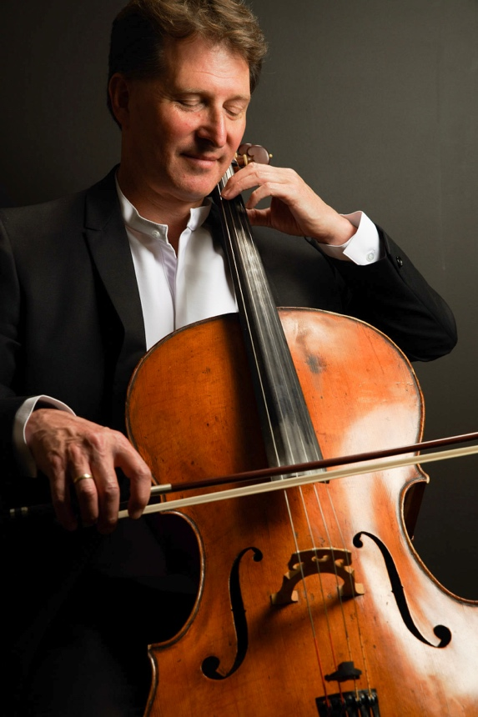
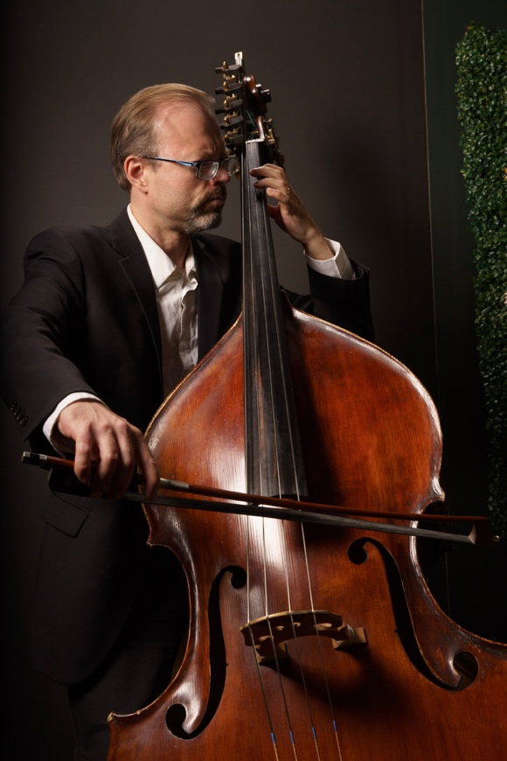
Instrument Families
featuring musicians of the Spokane Symphony
The Strings
The string section includes the violins, violas, cellos, and double basses. Notice the different sizes of instruments. The violin is the smallest and is held under the jaw when being played, while the double bass is so large that is must rest on the floor. Can you guess which instrument plays the highest pitch (relative highness or lowness of a sound)?
Xu Duo
Violin
Angela Mitchell
Viola
John Marshall
Cello
Stephen Swanson
Double Bass
d

Slide 5
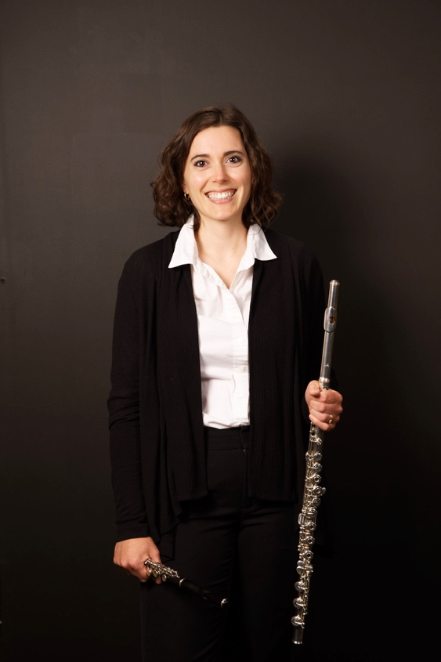
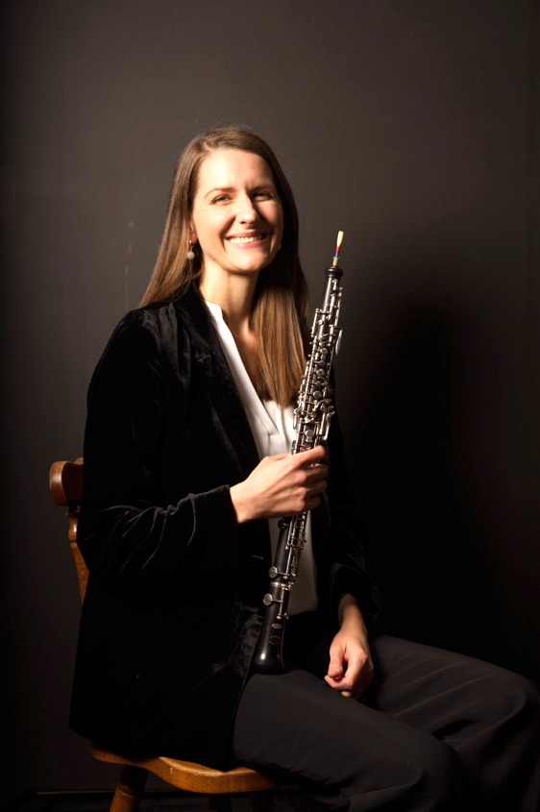
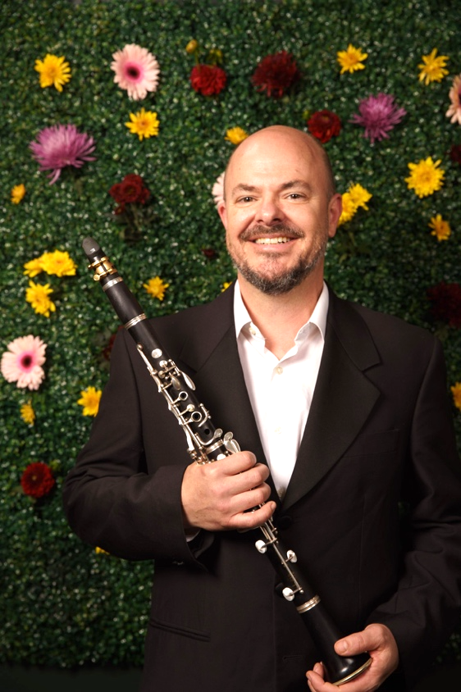
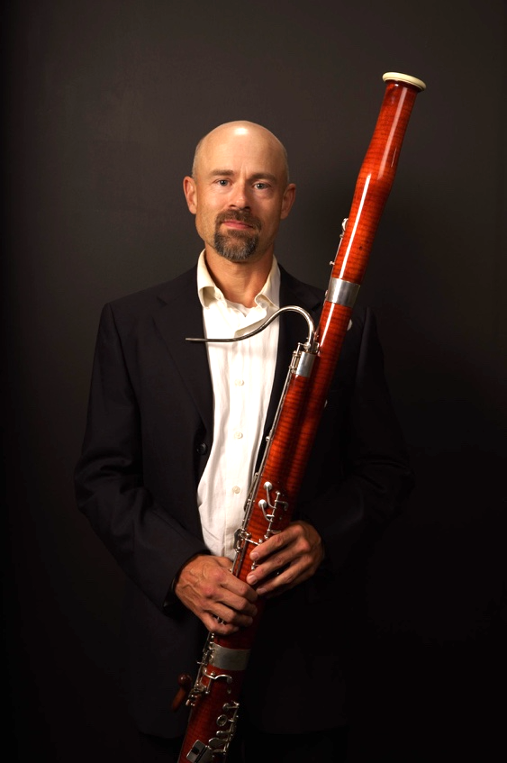
The Woodwinds
The woodwinds include the flutes (and piccolo, a very small flute), oboes, clarinets, and bassoons. Again, notice the different sizes of instruments. The piccolo is the smallest and the bassoon is the largest. Which one do you think plays the lowest pitches, the piccolo or bassoon?
Colleen McElroy
Flute and Piccolo
Shiela McNally
Oboe
Daniel Cotter
Clarinet
Luke Bakken
Bassoon

Slide 6
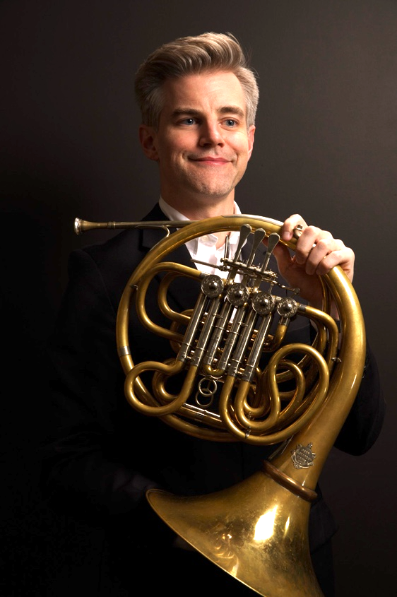
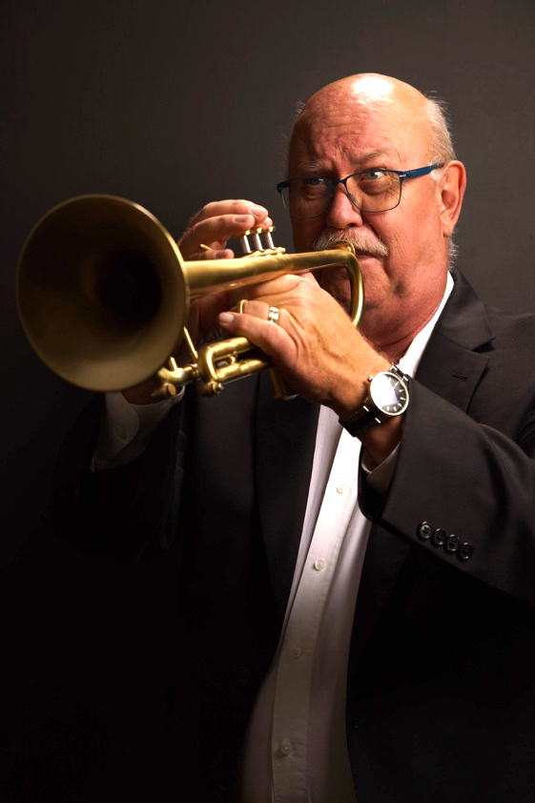
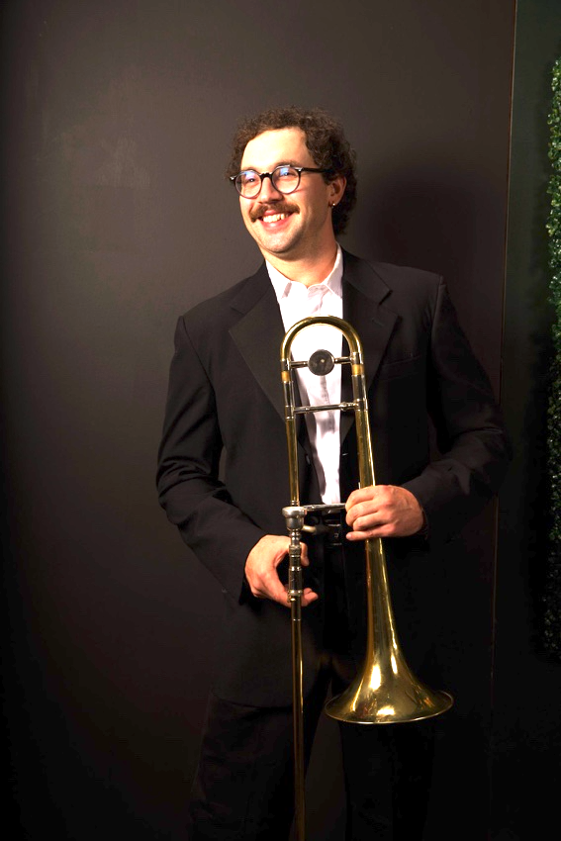
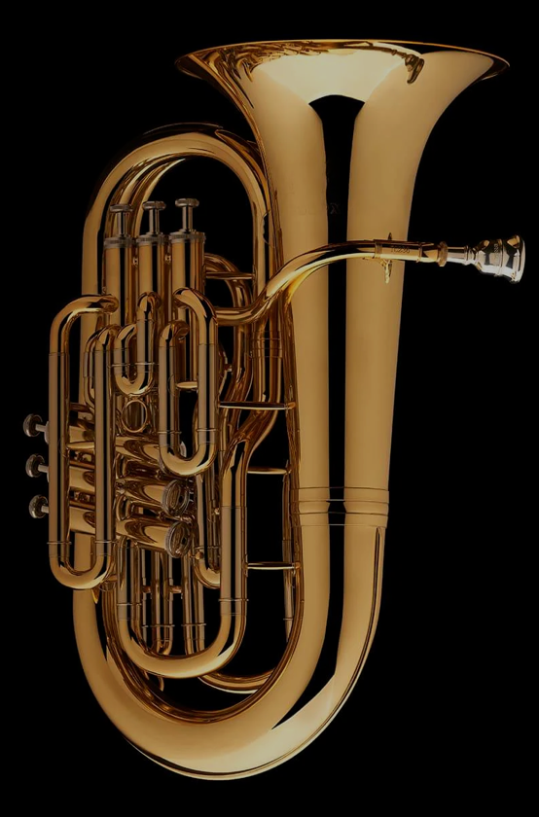
The Brass
The brass instruments include the horn, trumpet, trombone, and tuba. Notice the different sizes of instruments. The trumpet is the smallest and the tuba is the largest…you get the point by now! Smaller instruments create higher pitches and larger instruments make lower pitches.
Clinton Webb
Horn
Larry Jess
Trumpet
John Church
Trombone
Tuba

Slide 7
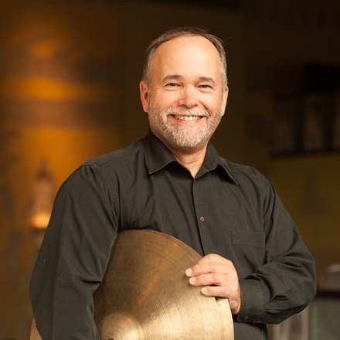
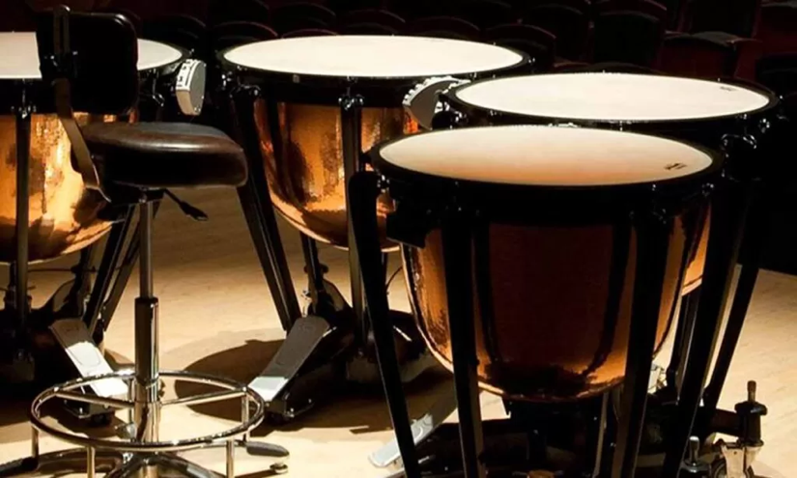
The Percussion
The percussion includes pretty much anything you can strike, scrape, shake, and more. The timpani are a set of pitched drums that are played by the orchestra’s timpanist. The auxiliary percussion is shared between several musicians and includes hundreds of instruments such as the xylophone, drums, bells, chimes, shakers, whistles, cymbals, gongs, and rain sticks. The harp is also considered a member of the percussion family since the sound is made from a “percussed” string.
Rick Westrick
Percussion
Timpani
Earecka Tregenza Moody
Harp

Slide 8
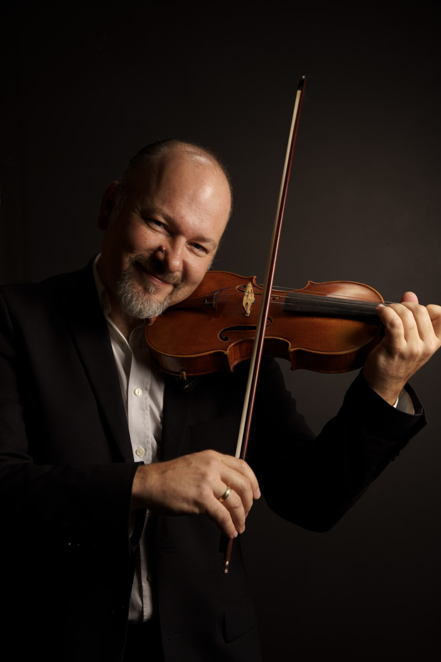
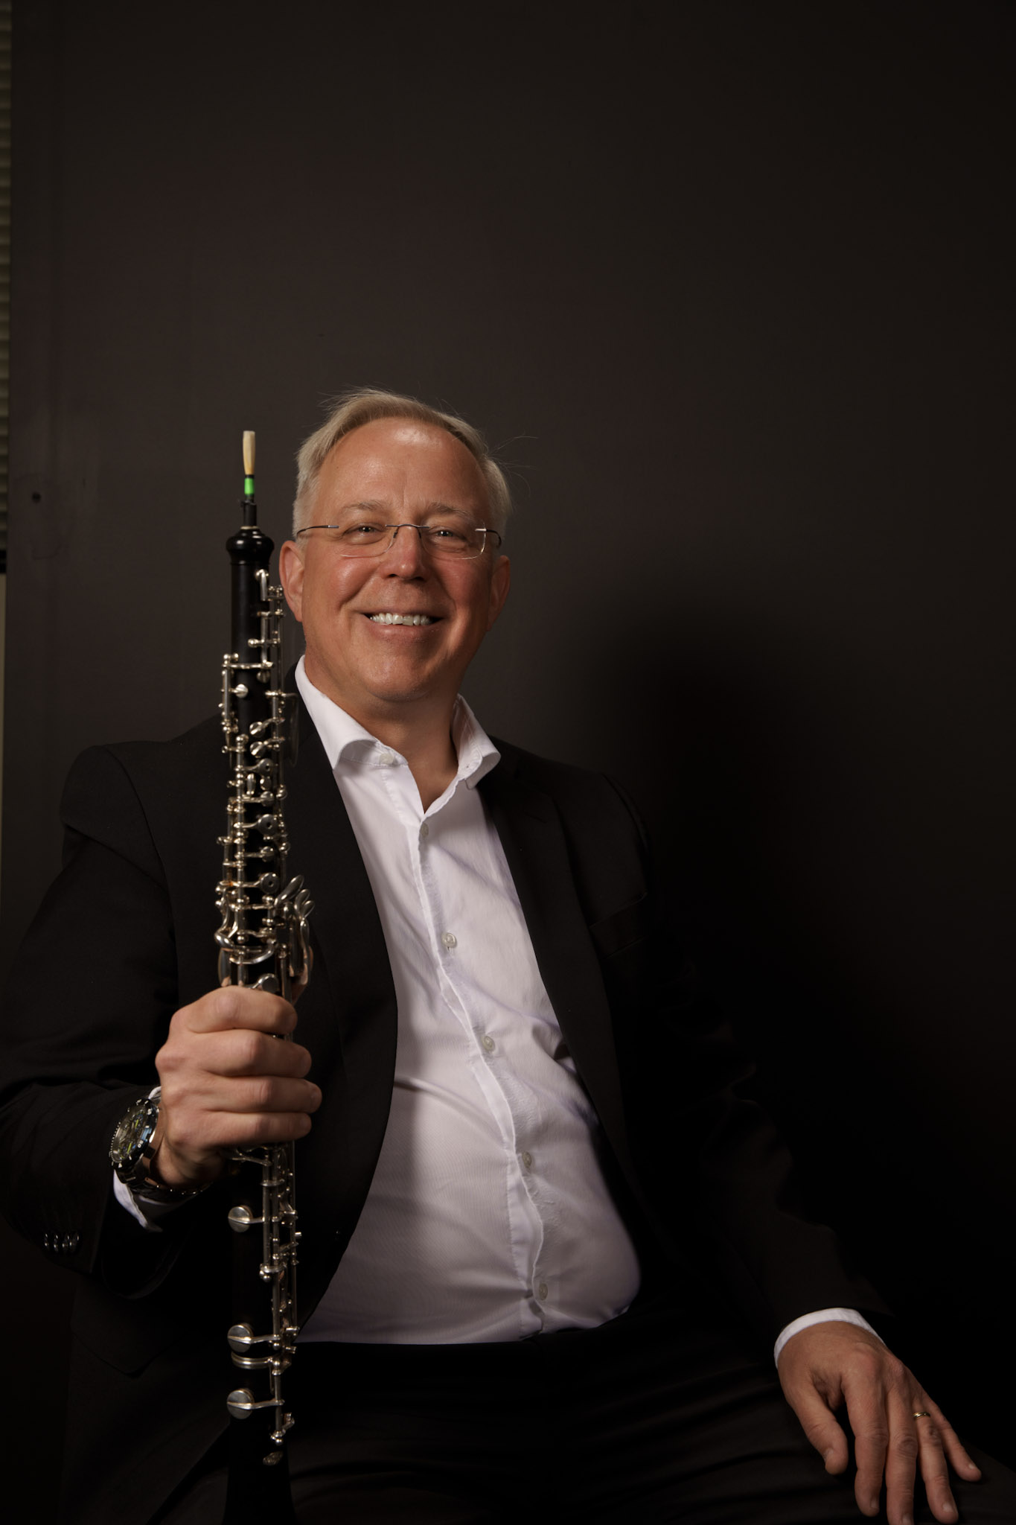
All the musicians on stage have an important role, but you’ll notice a few musicians that stand out when we first start our concert at the Fox Theater.
The concertmaster is the first chair violinist who serves as a sort of assistant to the conductor and helps lead the orchestra. The last musician to walk on stage before the conductor, the concertmaster bows for the applause and stands while the orchestra tunes.
The principal oboe plays an A for the whole orchestra to use for their tuning. First the brass and woodwinds tune, then the strings. The oboe is used for tuning since the instrument has a stable and very pure timbre (ˈtambər), which means the character or quality of a musical sound.
Mateusz Wolski, Concertmaster
Keith Thomas, Principal Oboe

Slide 9
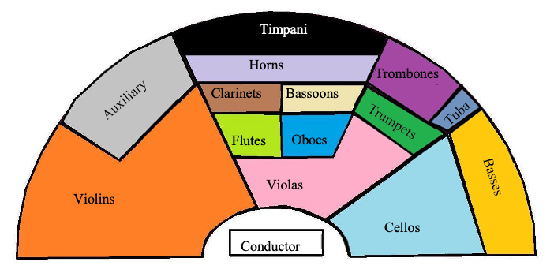
This is how the instrument groups are arranged on the stage. Notice how much larger the string sections are than the other instruments. Why do you think this is? (Hint: think about how much sound a single string instrument makes vs a single trombone)

Slide 10
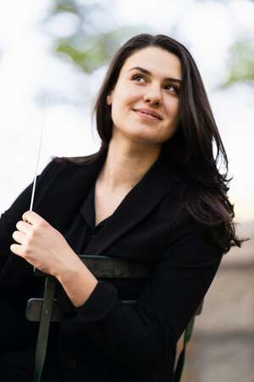
The Conductor
Shira Samuels-Shragg
Assistant conductor of the Dallas Symphony Orchestra
Former Assistant conductor of the Spokane Symphony
(We’re very proud of her new position in Dallas, but sad we
won’t get to work with her as much!)
Loves sharing music with young audiences and has conducted
concerts for over 60,000 students!
Conducted Carnegie Hall’s National Youth Orchestra of the USA
and served as their Assistant Conductor
Completed her masters in conducting at The Juilliard School
Studied conducting, piano, and German at Swarthmore College.

Slide 11
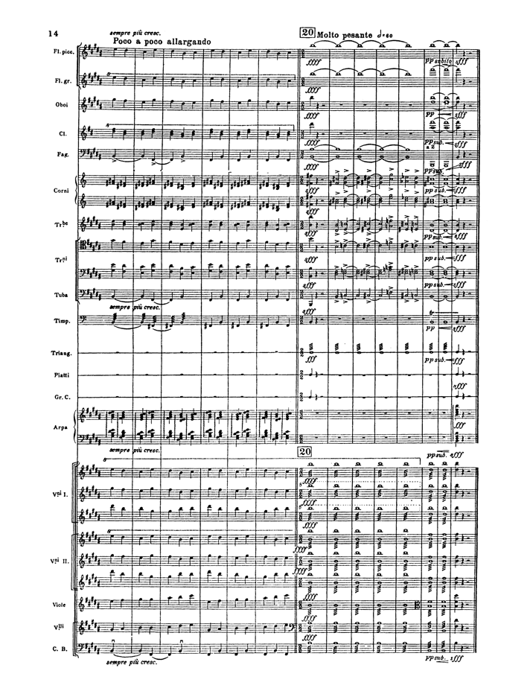
What is the conductor’s role in the orchestra?
First, the conductor chooses the music for the concert.
Second, the conductor studies the music so that they know every part that the musicians play, and how those parts fit together. Notice how many notes and markings the conductor sees on a single page of the Firebird score. Studying music is generally a solitary activity and must be done in advance of the first rehearsal.
Third, a conductor leads a rehearsal with musicians. During rehearsals the conductor helps align all the various instruments and parts. Until the rehearsal, the conductor has only imagined the music in their head. The conductor will sometimes talk to the musicians to convey their thoughts about the music, but more often they communicate their ideas through gestures, eye contact, and other body language. The conductor works on dynamics (how loud or soft the orchestra is playing), tuning, phrasing, articulation, and overall energy and communication within the orchestra.
Finally, the conductor performs the music with the orchestra in front of an audience. This is when all the hard work pays off! In the concert, no words are used to communicate with the musicians—only gestures, eye contact, and body language.

Slide 12
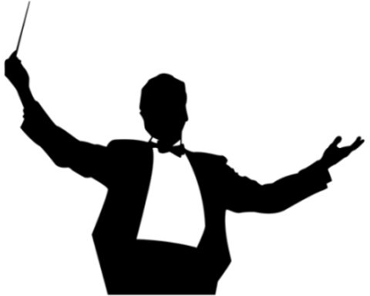
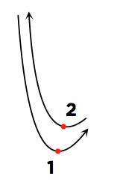
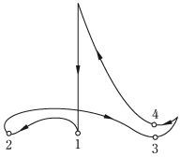
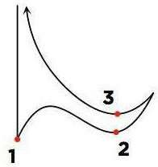
Learn to Conduct
When working with the musicians, you’ll see the conductor using their hands or a baton (basically, a stick painted white to make it more visible) to communicate with musicians. The conductor uses each of their hands differently. Generally, with the right hand they keep the beat with a specific pattern (see below), with the left hand, they communicate the expressive qualities of the music.
Conducting in 2
Conducting in 3
Conducting in 4

Slide 13
What to Expect at the Fox Theater for Symphony Day
  An usher will lead you from the lobby into the hall. You will be asked to walk in a single-file line to your seating area. The Fox Theater is a big place, and we don’t want you to get separated!
  After you reach your seats, teachers and students are asked to remain seated.
  Before the performance you’ll notice the musicians warming up onstage. Just as an athlete warms up before a game, the musicians also warm up. Sometimes this even includes stretching and exercises!
  When the lights go down you’ll know the concert is about to start. Please help welcome the concertmaster on stage with applause and listen as the orchestra tunes to the oboe.
  After the concertmaster sits down, the conductor will walk on stage. Again, let the conductor and musicians feel your excitement by clapping—the musicians will stand to thank you! Then get ready to listen.
  During the concert listen, watch, and enjoy. Let your imagination go! Does the music remind you of something you know? Does it make you feel excited, sad, peaceful, or frightened? There is no right or wrong answer: trust your experience and reactions to what you are seeing and hearing!
  Sometimes the conductor might ask the audience a question or ask you to clap along. This is your turn to add to the performance.
  After the orchestra plays the last piece and the clapping ends, please stay seated until the head usher points your way out. As you leave, make sure you have your personal belongings with you. When you exit the hall, please stay together in a single-file line.

Slide 14
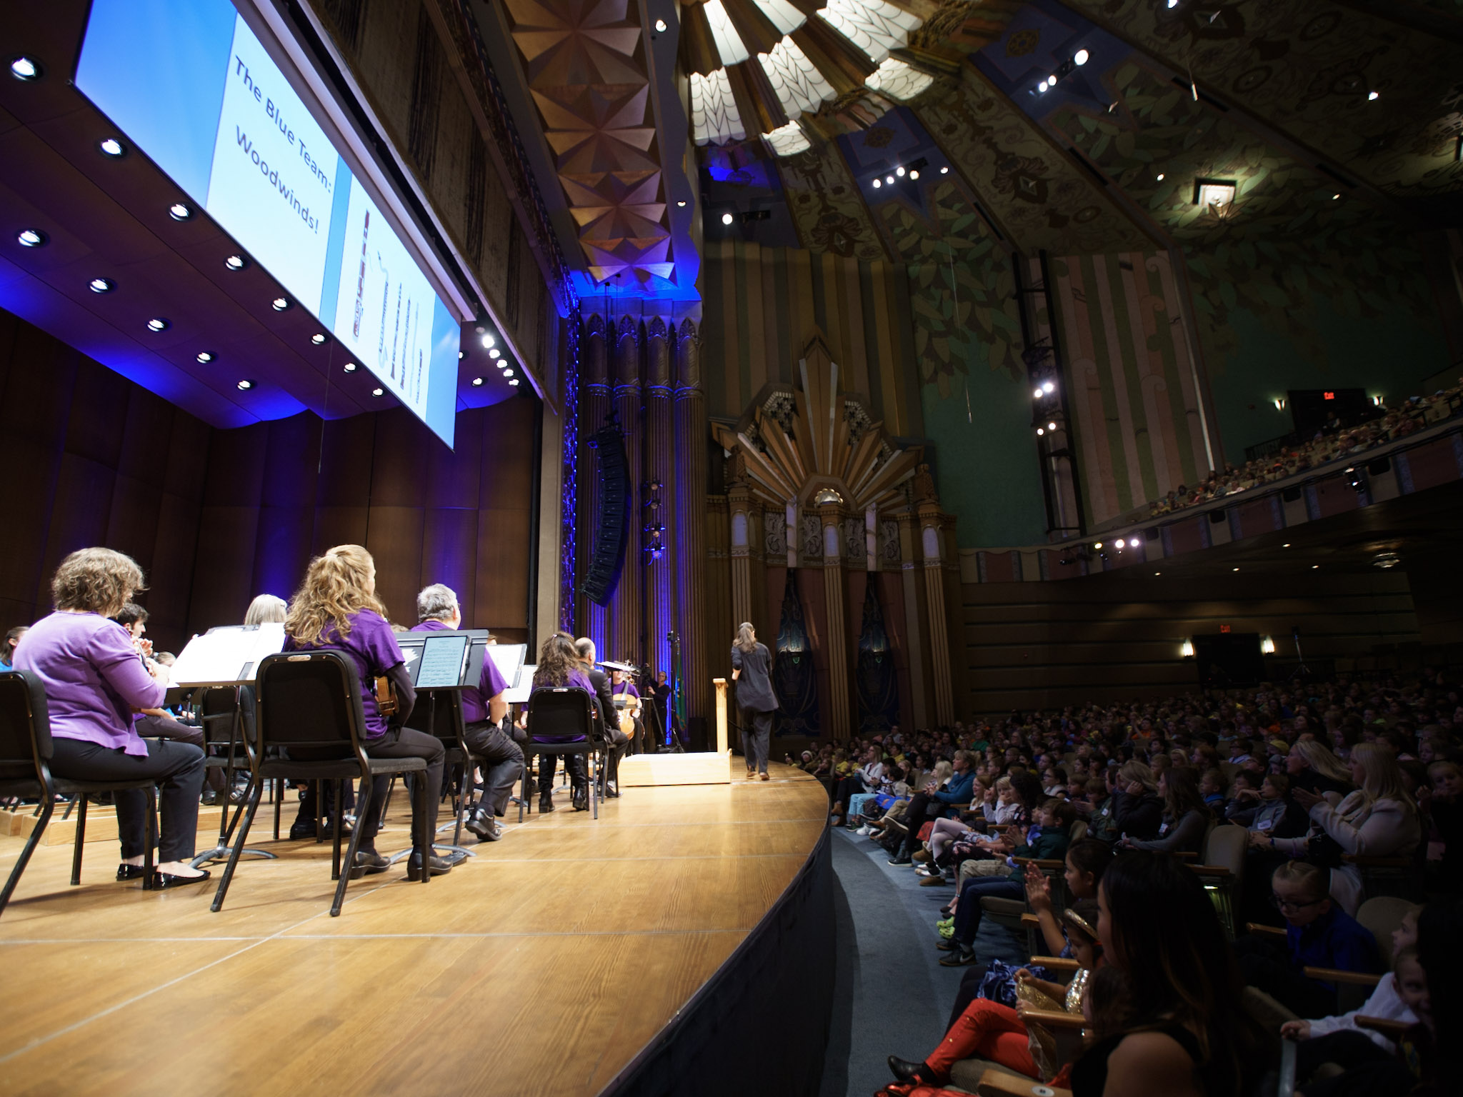
The theme of our concert is Heroes and Legends: Magical Musical Tales. The orchestra is going to take us on an adventure as we hear music based on all kinds of fairy tales, legends, and myths from around the world. In movies, music plays a key role in heightening drama, feeling the emotions of the main characters, and creating suspense as we wait to see what will happen.
However, music by itself can also generate strong emotions, convey ideas, and tell stories. Notice how each piece the orchestra plays communicates a different idea or mood, just through the music. Your own experience, background, and imagination will fill in the details!

Slide 15
Musical Emotions
Questions:
How do you communicate your feelings?
Does your voice sound the same if you are happy, scared, sad, or angry?
Do you move the same way when you are tired vs full of energy?
Can composers communicate emotion?
Composer’s Toolbox
Here are a few of the many ways composers create emotional impact and tell stories. When you listen to the program, see if you notice any of these in the music:
Dynamics (loud vs quiet)
Pitch range (high vs low)
Consonance and dissonant harmonies (pleasant vs harsh)
Speed (slow vs fast)
Melodic contour (does the melodic line go up, down, or like a roller coaster)
Orchestration (instrument combinations such as solo instrument vs entire orchestra)

Slide 16
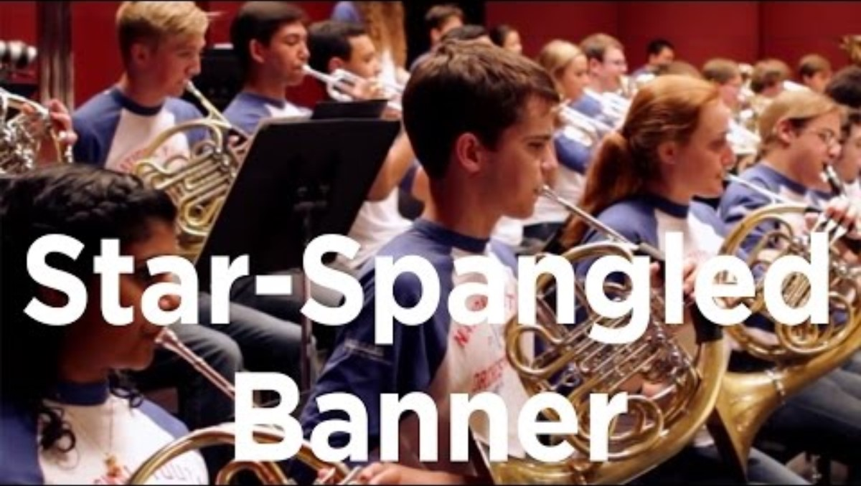
The Star-Spangled Banner
Music: John Stafford Smith
Lyrics: Francis Scott Key
https://www.youtube.com/watch?v=G0GFqrCcwes
O say can you see, by the dawn’s early light,
What so proudly we hail’d at the twilight’s last gleaming,
Whose broad stripes and bright stars through the perilous fight
O’er the ramparts we watch’d were so gallantly streaming?
And the rocket’s red glare, the bombs bursting in air,
Gave proof through the night that our flag was still there,
O say does that star-spangled banner yet wave
O’er the land of the free and the home of the brave?

Slide 17
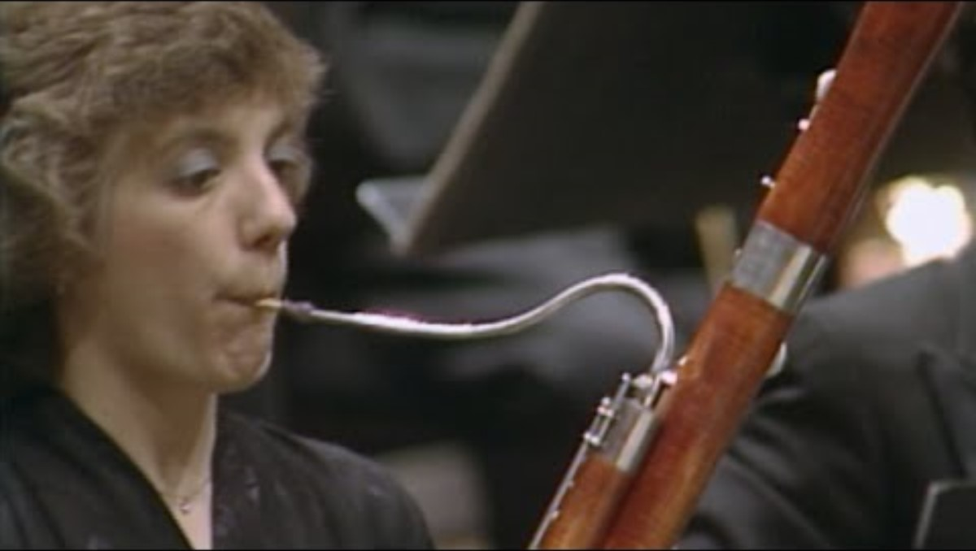
The Sorcerer’s Apprentice
Paul Dukas
https://www.youtube.com/watch?v=9lWvl3yVH_Y
Legend
Based on a poem by the German poet Goethe, the Sorcerer’s Apprentice tells the story of a magician’s apprentice who tries to cast a complex spell to make a broomstick fetch a bucket of water. However, his boss is away, and he doesn’t have the skill or training to control the magic, and all goes horribly wrong! The broomsticks end up flooding the entire house and the more he tries to stop them, the worse things get. Only when the magician returns is the spell broken and calm restored.
The bassoons and clarinets portray the mischievous broomsticks at the beginning
The strings plead for them to stop (0:30)
The magician returns (2:15): can you hear when he breaks the spell?
Does the orchestra play more slowly or quickly as the situation gets more and more out of control?
What do you think the apprentice felt like as he saw the house being destroyed by something he couldn’t stop? Have you ever tried to do something new and ended up with a mess?

Slide 18
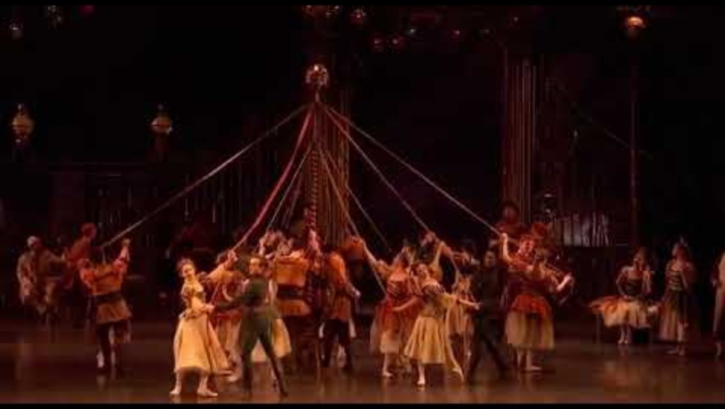
Waltz from Swan Lake, Op. 20, Act 1: No. 2
Peter Ilyich Tchaikovsky
https://www.youtube.com/watch?v=f6RTlmIjkw4
Legend
In the ballet Swan Lake, an evil magician has cursed the young women of a castle, turning them into swans by day and only allowing them to return to their human forms at night. When we join the story, the prince is throwing a ball and everyone at the party gets to dance a waltz.
A waltz is a type of dance in triple meter. Try saying “One two three, one two three” when listening to this piece and feel how the music has a strong rhythmic pulse and lilting quality.
Listen for the pizzicato at the beginning of the work. Pizzicato is where a string player plucks the string with their finger rather than using a bow. The tone is short and sounds a bit like a guitar.
What is the most important thing for dance music: dynamics or a strong rhythmic pulse?
Which instrument group play the melody (the main tune) most of the time in this movement?

Slide 19
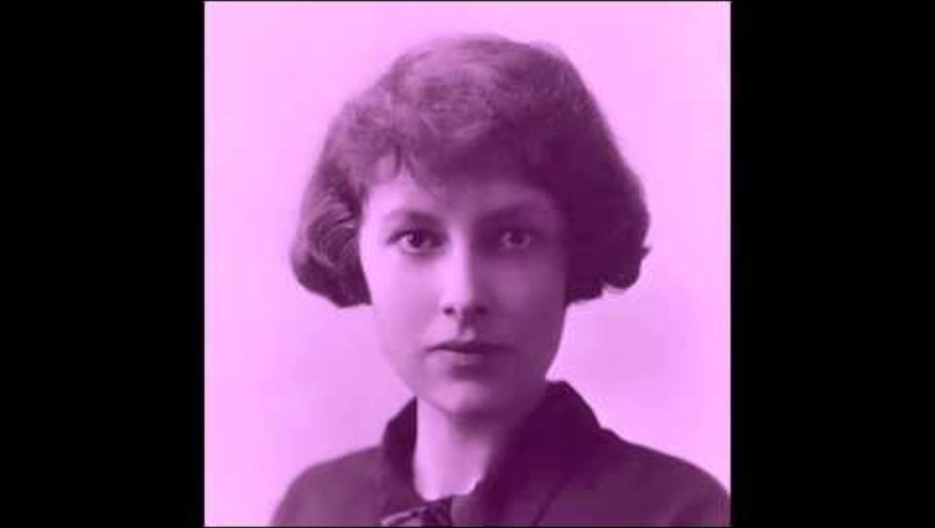
Legend of Rhiannon: The Conflict (mov. 1)
Grace Williams
https://www.youtube.com/watch?v=4-jYDF8xo74
Legend
In the 1900s, the Welsh composer Grace Williams was inspired to write music about the myths and legends of her people. For the hero of her musical story, she chose Rhiannon, a Celtic moon princess known for her strong will, intelligence, generosity, and courageous spirit. Tales of Rhiannon first appears in Mabinogi, a collection of myths and stories that date back over one thousand years.
The percussion heightens the drama and helps convey a battle scene. Why?
The movement the SSO will play is called “The Conflict.” Does the music match this title? Do you feel peaceful or stirred up when listening to this piece?
Can you imagine Rhiannon bravely riding her horse when you hear this music?

Slide 20
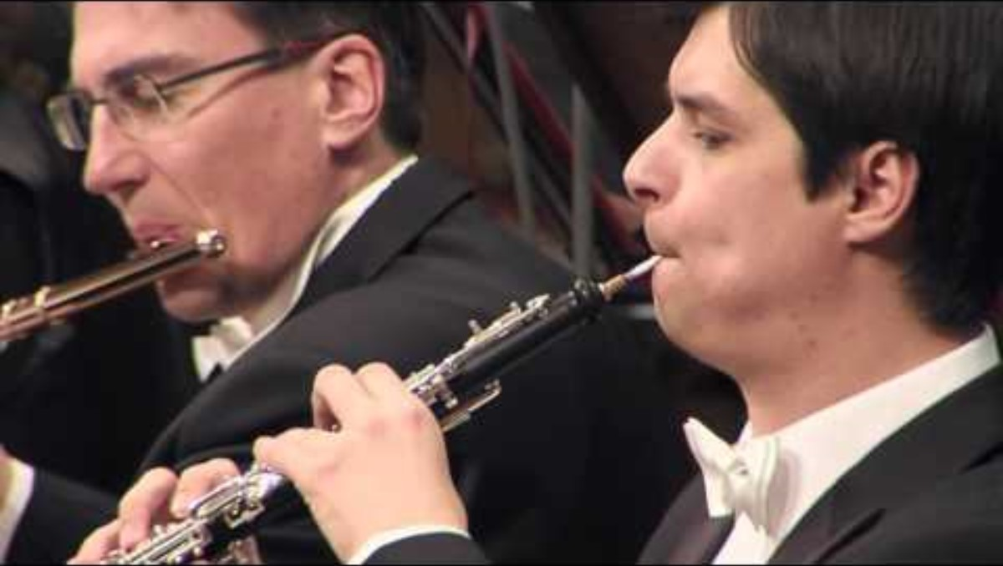
Morning Mood from Peer Gynt Suite No. 1
Edvard Grieg
https://www.youtube.com/watch?v=SS7-Gwz1Zio
Legend
Grieg’s Peer Gynt is loosely based on the Norwegian folk hero Per Gynt and the play Peer Gynt by Henrik Isben. While the Norwegian mythology describes our hero’s various exploits (including rescuing three dairy-maids from trolls), in Morning Mood, we find Gynt watching a sunrise over the desert, while making a wooden flute.
Notice how the music starts out quietly (piano) and grows louder (crescendos) throughout the piece.
The woodwinds have the melody at the start of the work, portraying the flute Peer is making.
Why does the orchestra start quietly and grow louder throughout the piece? (hint: what is Peer watching?)
Morning Mood is very popular and has been used in many movies and commercials. What is the emotion you feel when listening to the piece?

Slide 21
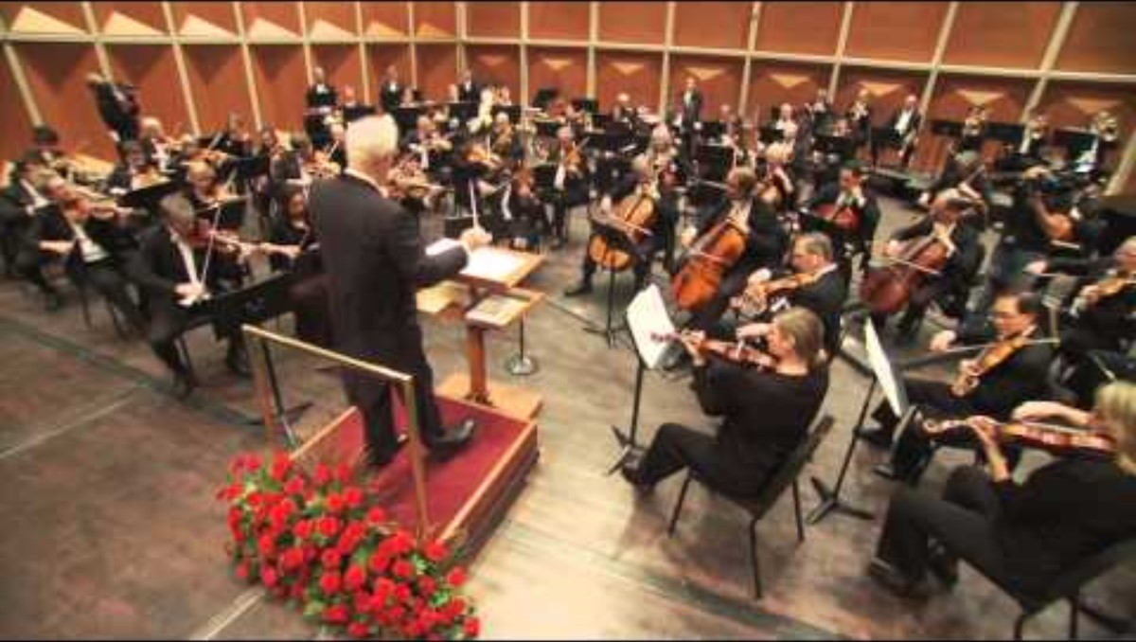
William Tell Overture
Gioachino Rossini
https://www.youtube.com/watch?v=YIbYCOiETx0
Legend
William Tell, was a folktale hero in Switzerland who bravely battled evil and injustice, while defending the common people of his country (sort of a Swiss version of Robin Hood). The Italian composer Giochomo Rossini, used this story to make an opera. An opera is like a play with music. Rather than speaking their lines, the performers on stage sing their lines. The story is told through both the singer’s and orchestra’s music.
Rossini wanted to create the excitement of an army of soldiers on horseback. Can you hear something like galloping horses?
Brass instruments have an important role in this piece. Traditionally, trumpets and horns are used as a call to action. Why brass instruments? (hint: are brass instruments generally loud or quiet?)
Notice how many fast notes the strings play!

Slide 22
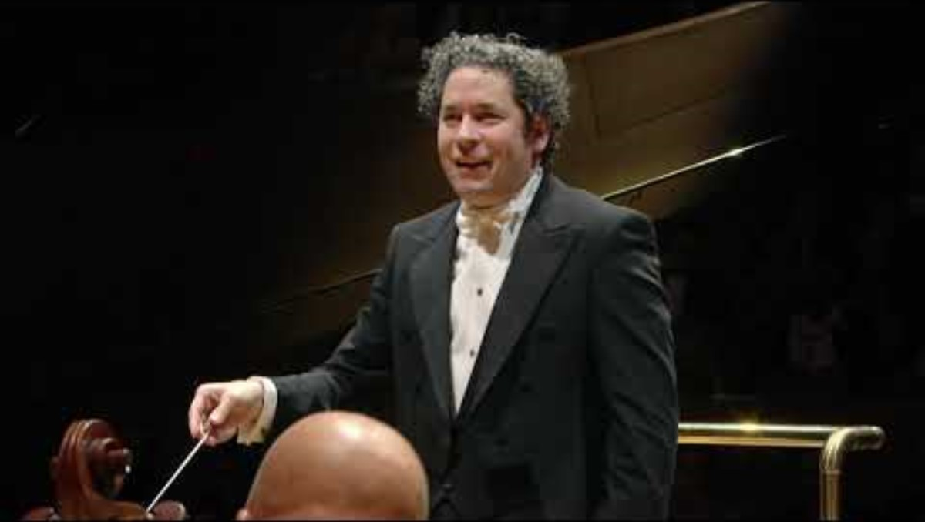
Firebird Suite: Finale
Igor Stravinsky
https://www.youtube.com/watch?v=rYcz-g8WpMc
Legend
Based on a Russian fairytale, The Firebird centers around a magical bird whose feathers have special powers. While the story is long (including the usual prince, princess, villain, dancing, and a strange magical egg), we’ll join the story at the conclusion. Everyone is just awakening from a long sleep.
Listen for the opening horn solo. Can you imagine the feeling of waking up from a bad dream and realizing it is a beautiful day and the nightmare you just had is over?
Notice how the orchestra starts from a place of peaceful quiet and builds to a joyful celebration. What are some of the compositional tools that Stravinksy uses to achieve this effect?
Can you hear the ascending melodic line played by the harp? Notice how the music keeps rising to higher and higher pitches.

Slide 23
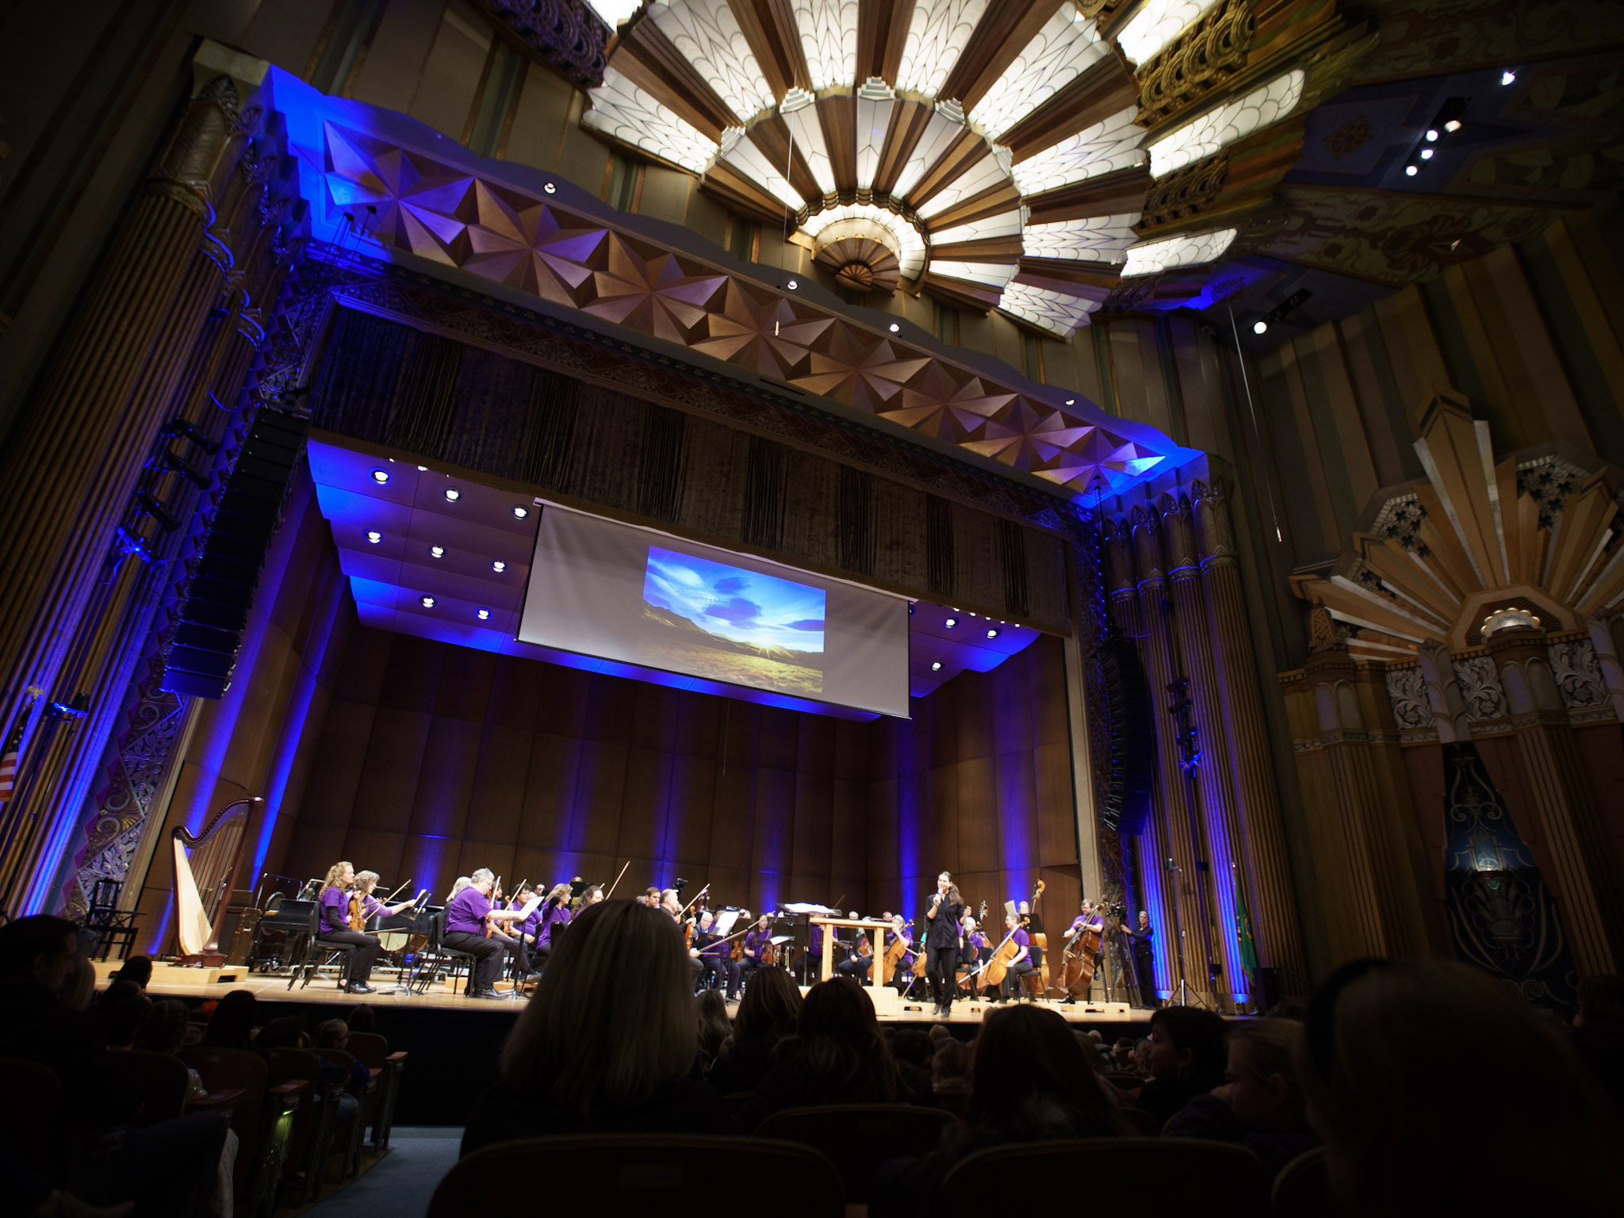
Martin Woldson Theater
at The Fox
When was the Fox Theater built?
The theater was first opened in 1931 as the Fox (movie) Theater.
The construction cost was $1 million in 1931, which would be about $16 million now.
What style of architecture is used?
The interior is designed in an Art Deco theme.
When was the theatre remodeled?
In November 2007 the Fox was reopened after a full renovation.
With help from the Save America’s Treasures grant, the original Art Deco murals were restored from damage that happened during previous renovations.
How many seats are in Martin Woldson Theater at The Fox?
There are about 1600 seats in the theater.

Slide 24






Special thanks to our education program sponsors: Hagan Foundation, Welty Foundation, National Endowment for the Arts, Johnston-Fix Foundation, Future Song Foundation, and the Washington State Arts Commission.
Welty Foundation

